Slide 1

ARTIFICIAL INTELLIGENCE
&
MACHINE LEARNING
Lab SESSION NO : 05

Slide 2
Experiment# 5 : Perform feature engineering on the real-world Titanic dataset by handling missing values, applying scaling and encoding techniques, and visualizing data using pair plots
In Lab
Write a Python program to:
• Load the Titanic dataset using pandas.
• Display basic information: number of rows, columns, missing values per column.
• Handle missing values:
• Impute missing ‘Age’ with median.
• Impute missing ‘Embarked’ with mode.
• Apply scaling:
• Standardize the ‘Fare’ column.
• Encode categorical columns:
• Apply one-hot encoding to ‘Sex’ and ‘Embarked’.
• Visualize data:
• Plot pairplots for numerical features grouped by ‘Survived’.
• Print the first 5 rows of the processed dataset.

Slide 3
Code
# Step 1 - Imports and load dataset
import pandas as pd
import numpy as np
from sklearn.preprocessing import StandardScaler, OneHotEncoder
import matplotlib.pyplot as plt
import seaborn as sns
%matplotlib inline
# Load CSV (change filename if needed)
df = pd.read_csv("Titanic-Dataset.csv")
# Step 2 - Overview
print("Shape:", df.shape)
print("\nFirst 5 rows:")
display(df.head())
print("\nMissing values (original):")
print(df.isnull().sum())

Slide 4
Code
# Step 3 - Impute missing values
# Impute Age with median
df["Age"].fillna(df["Age"].median(), inplace=True)
# Treat empty strings as NaN then impute Embarked with mode
df["Embarked"].replace('', np.nan, inplace=True)
df["Embarked"].fillna(df["Embarked"].mode()[0], inplace=True)
print("Missing values AFTER imputation (Age & Embarked):")
print(df.isnull().sum())

Slide 5
# Step 4 - Standardize Fare and show before/after
print("Fare - BEFORE scaling (first 8 rows):")
print(df["Fare"].head(8))
# If Fare has NaNs, fill with median so scaler won't fail
if df["Fare"].isnull().any():
print("Found missing Fare values - filling with median before scaling.")
df["Fare"].fillna(df["Fare"].median(), inplace=True)
scaler = StandardScaler()
# fit_transform expects 2D array -> we keep original Fare and add Fare_scaled column
df["Fare_scaled"] = scaler.fit_transform(df[["Fare"]])[:, 0]
print("\nFare_scaled - AFTER scaling (first 8 rows):")
print(df[["Fare", "Fare_scaled"]].head(8))

Slide 6
# Step 5 - Columns and Sex/Embarked before encoding
print("Columns BEFORE one-hot encoding:")
print(list(df.columns))
print("\nSex and Embarked (before encoding) - first 8 rows:")
print(df[["Sex", "Embarked"]].head(8))

Slide 7
# Step 6 - OneHotEncode Sex and Embarked (simple version, sklearn >= 1.2)
from sklearn.preprocessing import OneHotEncoder
# Create encoder
ohe = OneHotEncoder(drop='first', sparse_output=False)
# Fit & transform
encoded_arr = ohe.fit_transform(df[["Sex", "Embarked"]])
# Column names from encoder
encoded_cols = ohe.get_feature_names_out(["Sex", "Embarked"])
# Convert to DataFrame
encoded_df = pd.DataFrame(encoded_arr, columns=encoded_cols, index=df.index)
# Show encoded columns only
print("Encoded columns (first 8 rows):")
print(encoded_df.head(8))

Slide 8
#Step-7: Pair Plots
import seaborn as sns
import matplotlib.pyplot as plt
# Select numerical features for plotting
num_features = ["Pclass", "Age", "SibSp", "Parch", "Fare"]
# Make sure Survived is integer
df["Survived"] = df["Survived"].astype(int)
# Pairplot grouped by Survived
sns.pairplot(df[num_features + ["Survived"]], hue="Survived", diag_kind="hist", plot_kws={"alpha":0.6})
plt.suptitle("Pairplot of Numerical Features grouped by Survived", y=1.02)
plt.show()

Slide 9
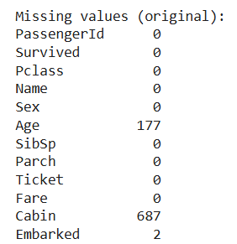
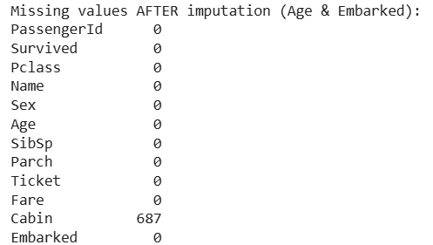
# Step-8. Display first 5 rows after processing data
final_df = pd.concat([df.drop(columns=["Sex", "Embarked", "Fare"]), encoded_df], axis=1)
# Show first 5 rows of processed dataset
print("First 5 rows of the final processed dataset:")
display(final_df.head())
Output-Final (Missing Values Count Before and after Imputation)

Slide 10
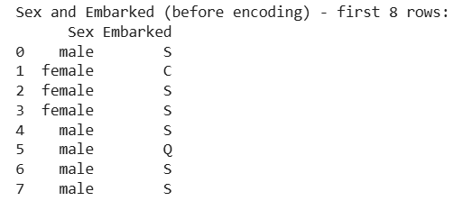
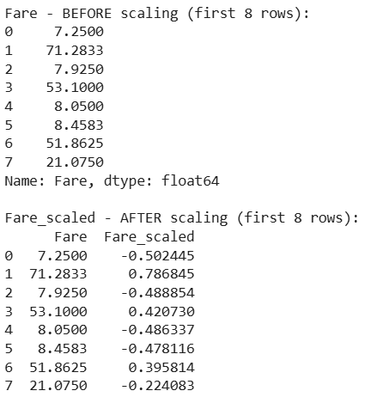
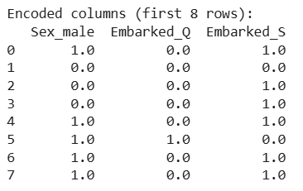
Scaling Outputs – Categorical & Numerical

Slide 11
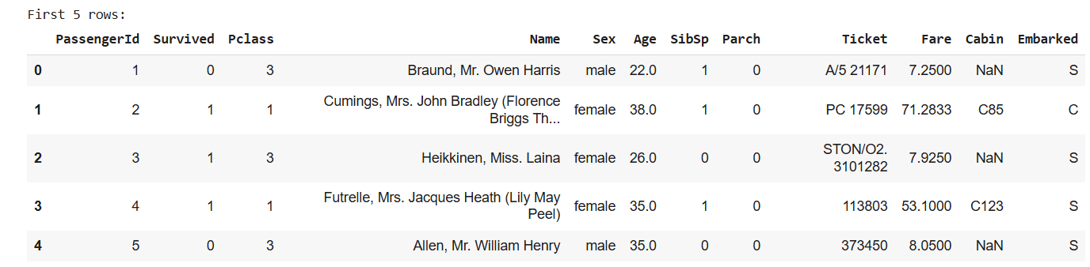
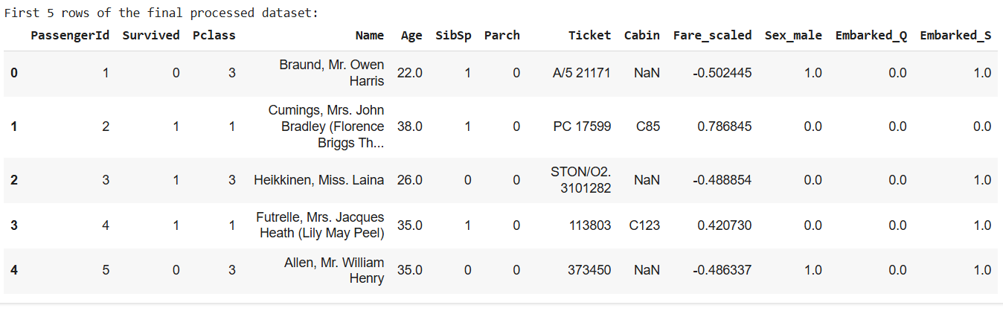
Final Output – Before Processing
Final Output – After Processing

Slide 12
Thank You

